Slide 1
Call Wild of the Wild
By:Torrelle Hardy
Author: Jack London

Slide 2
Summary
It's about a dog named buck who's the smallest dog in the area. But he was one the hardest workers out there. He weighed 140 pounds. One day he was guarding the judge and then he got kidnapped. He got tortured, beat, bullied and didn’t get fed. He eventually became a sled dog and try to get rivalry with Spitz for top dog. He became the leader of the sled dogs and then killed Splitz.

Slide 3
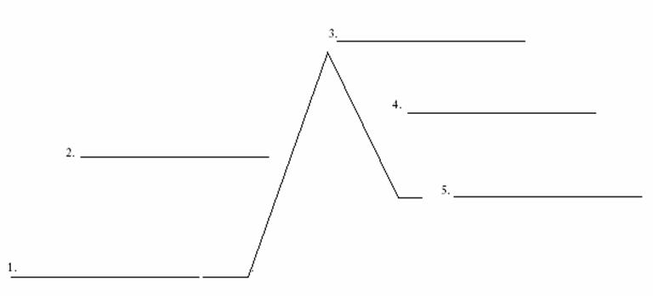
Became sled dog
Kills Splitz
Buck gets kidnapped and beaten
Became leader of the sled dogs
Buck is with Judge Miller

Slide 4
Setting
Jack London published book in 1903, it was places in Yukon territory. Present between Alaska and Canada. Also it took place during Klondike gold rush.

Slide 5
Main character traits and point of view
Main characters:
Miller
Buck
Francios
Thorton
and Splitz
The main character traits is that Thorton and Buck bond is so strong I stop from buck going crazy, also they are devoted to each other.
The point of view of the story is that Buck is a 140lbs dog that is a mix breed. And the book is in third person it is telling what struggles Buck goes through.

Slide 6
Main conflict
The main conflict is Buck vs. His instincts is the call of the wild Which has suppressed by southland. These instincts is from a long time ago.
Evidence is because how buck is always trying to fight Splitz, like Splitz kept having rivalry. Also it said In the story he tested Splitz with a fight.

Slide 7
Theme #1
The theme of the story is never give up, because in the story Buck never gave up on himself to become leader.

Slide 8
Theme 2
If u put your mind into something u can do anything. The reason I said this because, Buck became leader and defeated Splitsz.

Slide 9
Theme 3
Always have somebody by your side, the reason I say this because Thorton was by Buck said threw good and bad times.

Slide 10
Compared
This book compared to the Avengers Is way different. This book is more 1900s and Avengers is more future and Super heroes. Also Avengers has more action in it, than Call of the wild. What have in common is that they both want rivalry and has action, also the book and the movie has family and people sticking together. The reason I said family for the call of the wild Is because he became leader and Buck had Thorton.

Slide 11
Sign post
Contrast and Contradiction: When how Buck was hunting dog , most athletic even though he was the smallest and not the strongest.

Slide 12
Conclusion
The conclusion of the story is that never give up and keep on grinding to be successful. And Buck defeated spitz ,also Buck and Thorton and became friends. The most memorable aspect when Buck defeated spitz. And this is important novel because it shows to never give up. I would recommend this book to people because it shows a good lesson. No matter how big or small you can do anything.

